Slide 1
CS2040S Tutorial 3
Done by Xiao Yan

Slide 2
Recap

Slide 3
Quick Sort
Following slides credit to Christian

Slide 4
Quick Sort
The idea:
Choose a pivot (and hope it’s not a bad one)
Partition the array into regions of smaller and larger than the pivot
Recursively sort the regions

Slide 5
Analysis of Quicksort
(Refer to lecture slides for more details)

Slide 6
Analysis of Quicksort
(Refer to lecture slides for more details)
If we randomly choose the pivot:
Average Case: O(nlogn) time
Worst-Case: O(n²) time
Space: O(1) space because only swappings are required

Slide 7
Randomization
Why?

Slide 8
Randomization
Why?
Guarding against worst case

Slide 9
Randomization
Why?
Guarding against worst case
(if you choose the pivot randomly, the “wizard” cannot know what array to give you for the worst case)
Better probability of success
Notes:
For a given array, you dont want to _always_ get the same worst case

Slide 10
Qn 1a
Suppose that the pivot choice is the median of the first, middle and last keys, can you find a bad input for QuickSort?

Slide 11
Qn 1 Answer
Yes! As long as we have a fixed pivot choice, the time complexity would remain at O(n^2) as it is always possible to find a bad input for the algorithm.

Slide 12
Qn 1 Answer
Yes! As long as we have a fixed pivot choice, the time complexity would remain at O(n^2) as it is always possible to find a bad input for the algorithm.
For example (the underlined section indicates the subarray that is currently being recursed on, bolded are the first, middle and last keys):
1st Partitioning : [8, 3, 2, 1, 5, 4, 6, 7, 9] (8 will be selected as the pivot)
2nd Partitioning : [7, 3, 2, 1, 5, 4, 6, 8, 9] (6 will be selected as the pivot)
3rd Partitioning : [4, 3, 2, 1, 5, 6, 7, 8, 9] (4 will be selected as the pivot)
4th Partitioning : [1, 3, 2, 4, 5, 6, 7, 8, 9] (2 will be selected as the pivot)

Slide 13
Qn 1b
Are any of the partitioning algorithms we have seen for QuickSort stable? Can you design a stable partitioning algorithm? Would it be efficient?

Slide 14
Qn 1b Answer
No, all partitioning algorithms are not stable.
But we can make them stable! How?

Slide 15
Qn 1b Answer
Create a new array with the original indices of the key
Original Array : [1, 2, 5, 3, 5, 3, 8, 7, 2]
New Array : [0, 1, 2, 3, 4, 5, 6, 7, 8]
When comparing elements, the new array would be used to disambiguate elements with equal keys, creating a “total ordering” between every key.
When comparing the 2s, sorting algorithm will check which value came first using the new array of original indices

Slide 16
Qn 1b Answer
*** Note: The partitioning algorithm will no longer be in place and require an extra O(n) space

Slide 17
Qn 1c
Consider a QuickSort implementation that uses the 3-way partitioning scheme (i.e. elements equal to the pivot are partitioned into their own segment).
i) If an input array of size n contains all identical keys, what is the asymptotic bound for QuickSort?

Slide 18
Qn 1c (i) Answer
O(n)
After first pass, no more unsorted elements

Slide 19
Qn 1c
Consider a QuickSort implementation that uses the 3-way partitioning scheme (i.e. elements equal to the pivot are partitioned into their own segment).
(ii) If an input array of size n contains k < n distinct keys, what is the asymptotic bound for QuickSort?

Slide 20
Qn 1c (ii) Answer
Maximum of k pivots that can be chosen → max height of recurrence tree is k
Assume worst case for every level O(n)
Runtime:
Worst case: n * k = O(nk)
Average case: O(nlogk)

Slide 21
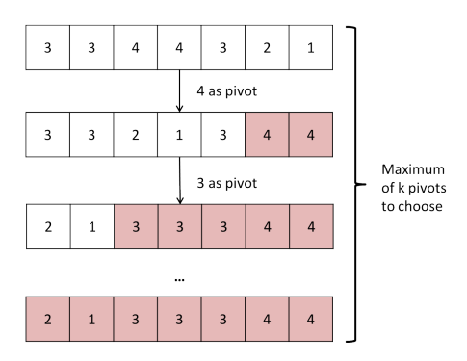
Qn 1c (ii) Answer
Example:
k = 4

Slide 22
Qn 1c (ii) Answer
Example:
k = 4

Slide 23
Qn 1c (ii) Answer
Example:
k = 4

Slide 24
Qn 1c (ii) Answer
Example:
k = 4

Slide 25
Qn 2a
Given an array A, decide if there are any duplicated elements in the array.

Slide 26
Qn 2a Answer
Sort → O(n log n)
Traverse array, check if i is same as i + 1 → O(n)
Overall: O(n log n) time, O(1) space

Slide 27
Qn 2a Answer
Iterate through the array and store each element into a set
If element already exists, return true
Overall: O(n) time, O(n) space

Slide 28
Qn 2b
Given an array A, output another array B with all the duplicates removed. Note the order of the elements in B does not need to follow the same order in A. That means if array A is {3, 2, 1, 3, 2, 1}, then your algorithm can output {1, 2, 3}.

Slide 29
Qn 2b Answer
Similar to 2a
Sort → O(n log n)
Variable k to keep track of largest element encountered → O(n)
Remove if element at index i is identical to k
Update the value of k if not duplicate
Overall: time O(n log n), space O(1)

Slide 30
Qn 2c
Given arrays A and B, output a new array C containing all the distinct items in both A and B. You are given that array A and array B already have their duplicates removed.

Slide 31
Qn 2c Answer
Merge sort!
Sort both arrays in ascending order and do the merge step of merge sort
If element has already been added to array C, advance the pointer
Overall: O(n log n) time, O(n) space

Slide 32
Qn 2d
Given array A and a target value, output two elements x and y in A where (x+y) equals the target value.

Slide 33
Qn 2d Answer
Sort (again!)
Use two pointers, low and high
If the target is less than the required value, low++
If the target is greater than the required value, high--
Overall: O(n log n)

Slide 34
Qn 3 Child Jumble
Come up with an eﬃcient algorithm to match each child to their shoes.
Luckily, their feet (and shoes) are all of slightly diﬀerent sizes. Unfortunately, they are all very similar, and it is very hard to compare two pairs of shoes or two pairs of feet to decide which is bigger. As such, you cannot compare shoes to shoes or feet to feet.
The only thing you can do is to have a toddler try on a pair of shoes.

Slide 35
Qn 3 Child Jumble
We can use quicksort!
The basic solution is to choose a random pair of shoes (e.g., the red Reeboks), and use it to partition the kids into “bigger” and “smaller” groups. Along the way, you ﬁnd one kid (“Alex”) for whom the red Reeboks ﬁt.

Slide 36
Qn 3 Child Jumble
If you choose the “pivot” shoes at random, you will get exactly the QuickSort recurrence, which results in a runtime of O(n log n) where n is the number of children.

Slide 37
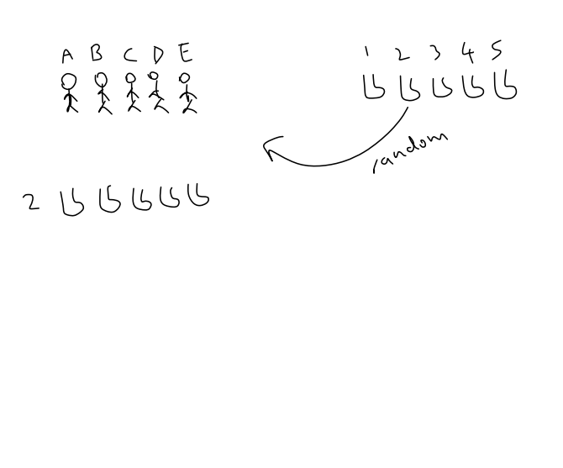

Slide 38
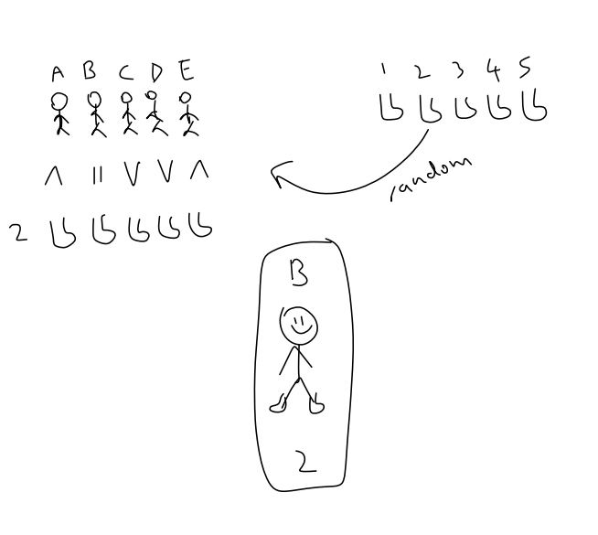

Slide 39
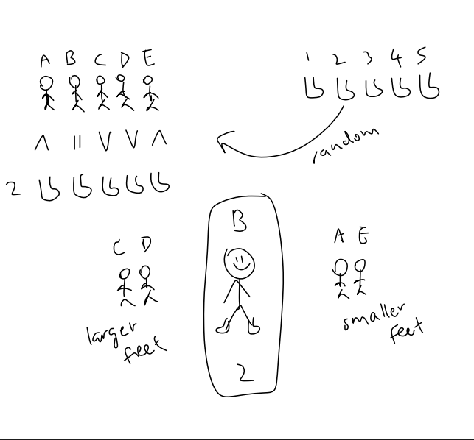

Slide 40
Qn 4
Quicksort is pretty fast. But that was with one pivot.
Can we use two or more pivots? What would the asymptotic running time be?

Slide 41
Qn 4a) + b)
Given magic box that chooses k perfect pivots that separate the elements evenly, how would a partitioning algorithm work using these pivots?
And what would be the asymptotic running time of this partitioning algorithm? Give your answer in terms of the number of elements n, and the number of pivots k

Slide 42
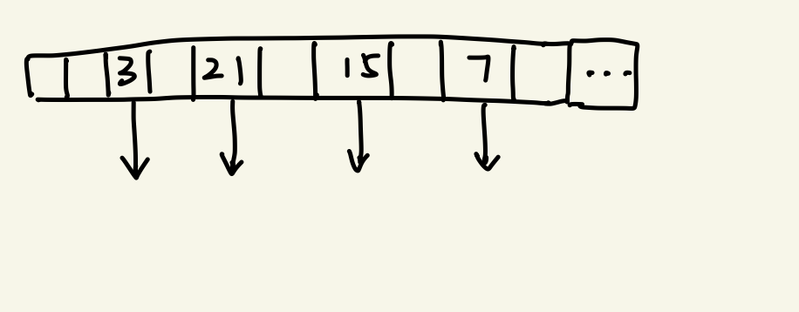

Slide 43
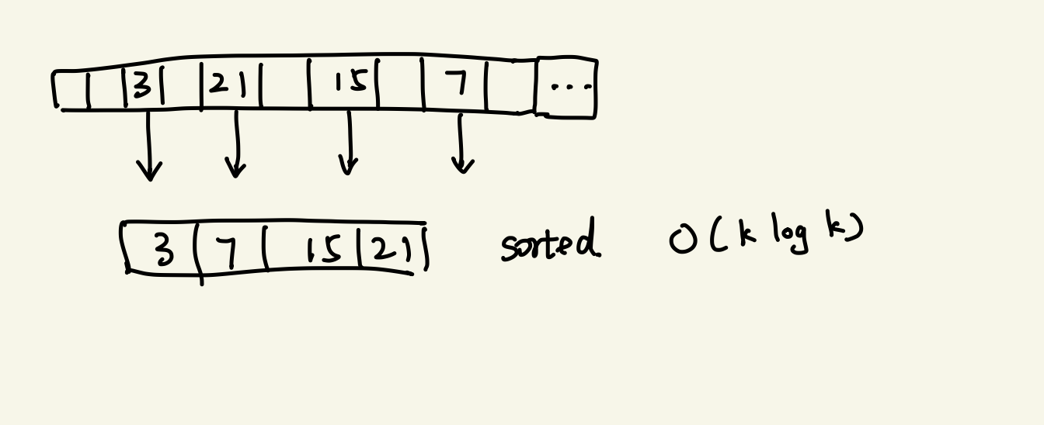

Slide 44
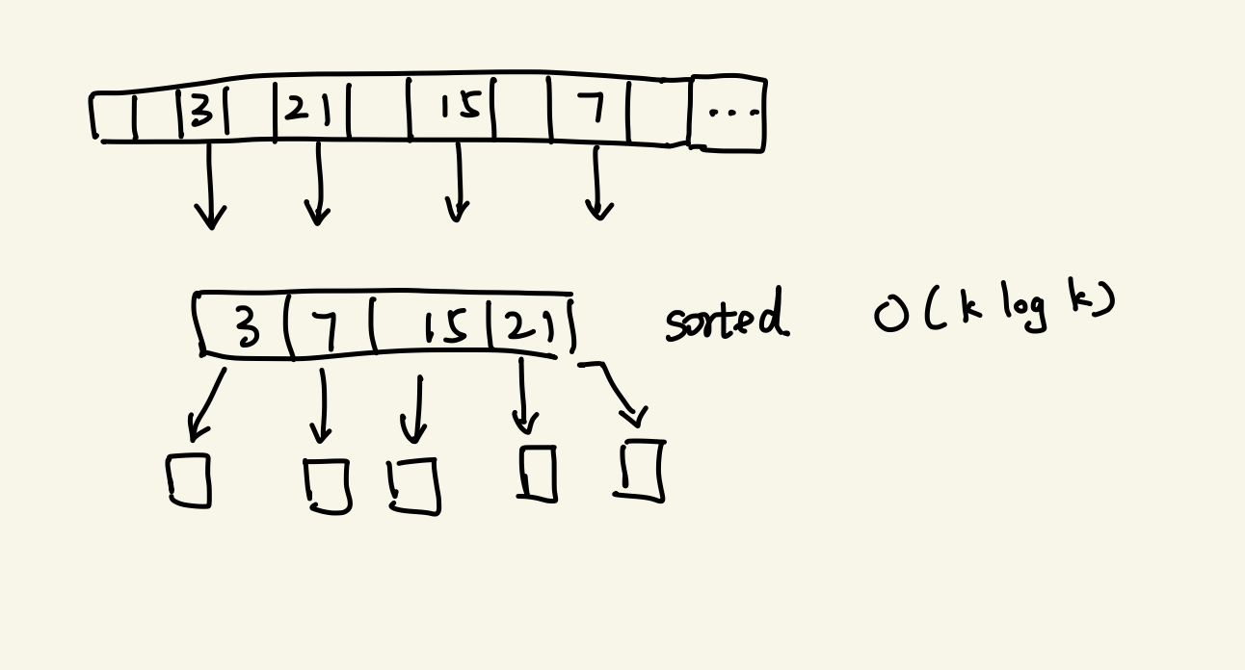

Slide 45
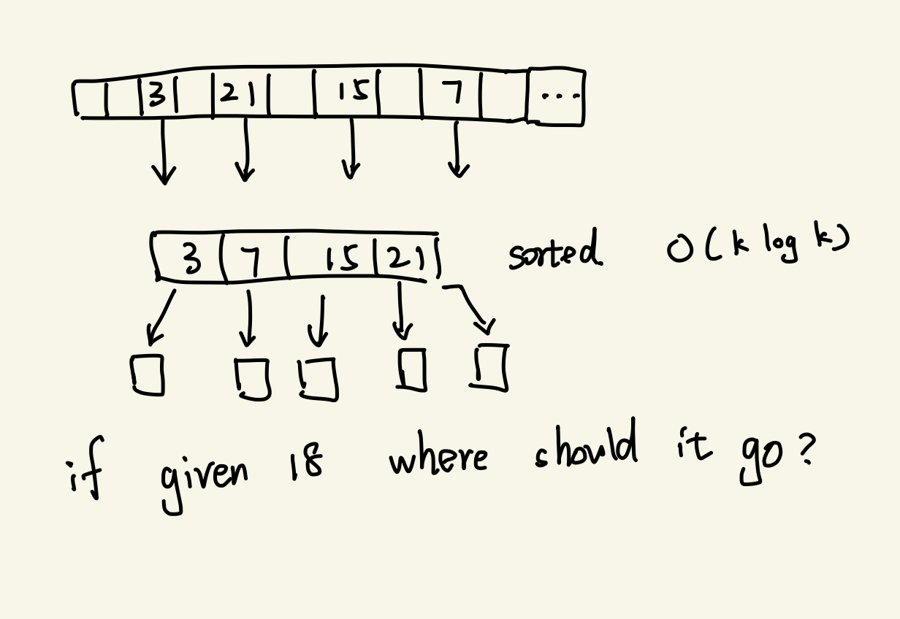

Slide 46
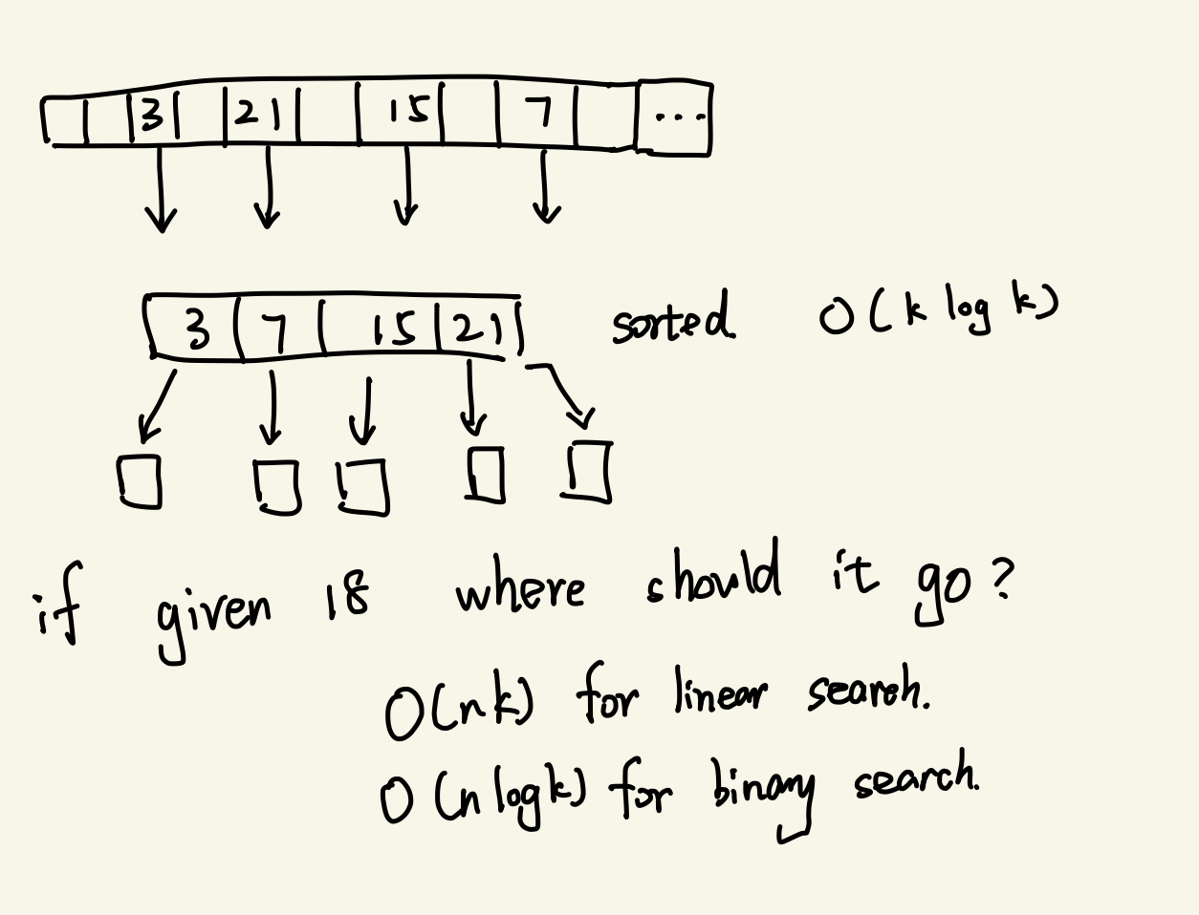

Slide 47
Qn4 b) Answer
O(klogk) + O(nlogk) = O(nlogk) as n >= k

Slide 48
Qn 4c) + d)
Formulate a recurrence relation that represents the asymptotic running time of quicksort with k pivots. Answer in terms of n and k
Solve the recurrence relation above. Is this better than quick sort in terms of time complexity?

Slide 49
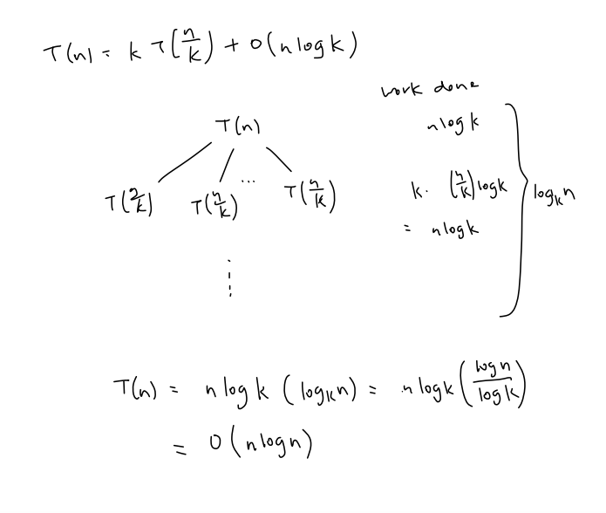

Slide 50
But..
Experimentally, 2-pivot and 3-pivot QuickSort is actually faster than regular 1-pivot QuickSort!
Java standard library uses 2-pivot QuickSort
2-pivot partitioning is similar to 3-way partitioning scheme for duplicates from lecture

Slide 51
Qn 4 (2 pivot Quicksort Example)
[57 8 42 75 29 77 38 24]
57 and 24 are chosen as pivots
Sort them (so that other elements can binary search the segments to be placed in

Slide 52
Qn 4 (2 pivot Quicksort Example)
[57 8 42 75 29 77 38 24]
57 and 24 are chosen as pivots
Sort them (so that other elements can binary search the segments to be placed in
After first partitioning:
[8 24 42 38 29 57 75 77]

Slide 53
Qn 4 (2 pivot Quicksort Example)
[57 8 42 75 29 77 38 24]
57 and 24 are chosen as pivots
Sort them (so that other elements can binary search the segments to be placed in
After first partitioning:
[8 24 42 38 29 57 75 77]
Next: recurse in the left segment (8), middle segment (42 38 29), and right segment (75 77).

Slide 54
Qn 5 Integer Sort (a)
How to sort 0s and 1s efficiently?
Could it be in-place? Is it stable?
01011100011010

Slide 55
Qn 5 Integer Sort (a)
How to sort 0s and 1s efficiently?
Could it be in-place? Is it stable?
Since there are only two "types" of elements in the array now, how could you simplify the problem?
0 1 0 1 1 1 0 0 0 1 1 0 1 0

Slide 56
Qn 5 Integer Sort (a)
Use QuickSort partitioning with two pointers, one at each side.
0 1 0 1 1 1 0 0 0 1 1 0 1 0
zero ptr

Slide 57
Qn 5 Integer Sort (a)
Use QuickSort partitioning with two pointers, one at each side.
0 1 0 1 1 1 0 0 0 1 1 0 1 0
zero ptr
find the first 1

Slide 58
Qn 5 Integer Sort (a)
Use QuickSort partitioning with two pointers, one at each side.
0 1 0 1 1 1 0 0 0 1 1 0 1 0
zero ptr
find the first 1
one ptr
find the first 0

Slide 59
Qn 5 Integer Sort (a)
Swap!
0 0 0 1 1 1 0 0 0 1 1 0 1 1
zero ptr
find the first 1
one ptr
find the first 0

Slide 60
Qn 5 Integer Sort (a)
Find the next pair that could be switched.
0 0 0 1 1 1 0 0 0 1 1 0 1 1
zero ptr
find the first 1
one ptr
find the first 0

Slide 61
Qn 5 Integer Sort (a)
Find the next pair that could be switched.
0 0 0 1 1 1 0 0 0 1 1 0 1 1
zero ptr
find the next 1
one ptr
find the next 0

Slide 62
Qn 5 Integer Sort (a)
Swap! (And repeat)
Runtime: O(n) - only going through the array once.
0 0 0 0 1 1 0 0 0 1 1 1 1 1
zero ptr
find the next 1
one ptr
find the next 0

Slide 63
Qn 5 Integer Sort (b)
Now consider sorting an array consisting of integers between 0 and M, where M is a small integer.
(This time, do not try to do it in-place; you can use extra space to record information about the input array and you can use an additional array to place the output in.)
0 1 2 2 1 4 3 4 3 3 1 3 2 0

Slide 64
Qn 5 Integer Sort (b)
First, go through the array once counting how many of each element you have.
0 1 2 2 1 4 3 4 3 3 1 3 2 0
Element Value | Count
0 | 2
1 | 3
2 | 3
3 | 4
4 | 2

Slide 65
Qn 5 Integer Sort (b)
(2) Go through the array and compute where the ﬁrst element for each value should go in the output array.
0 1 2 2 1 4 3 4 3 3 1 3 2 0
Element Value | Count | Where the first index should be in output array
0 | 2 | Index 0
1 | 3 | Index 2 (=0+2)
2 | 3 | Index 5 (=2+3)
3 | 4 | Index 8 (=5+3)
4 | 2 | Index 12(=8+4)

Slide 66
(3) Now iterate through the input array and copy each item into the proper place indicated by the pointer. Then advance the pointer.
0 1 2 2 1 4 3 4 3 3 1 3 2 0
Element Value | Count | pointers that point to the beginning of each block for each value
0 | 2 | Index 0
1 | 3 | Index 2 (=0+2)
2 | 3 | Index 5 (=2+3)
3 | 4 | Index 8 (=5+3)
4 | 2 | Index 12(=8+4)

Slide 67
(3) Now iterate through the input array and copy each item into the proper place indicated by the pointer. Then advance the pointer.
0 1 2 2 1 4 3 4 3 3 1 3 2 0
Element Value | Count | Pointers that point to the beginning of each block for each value
0 | 2 | Index 0
1 | 3 | Index 2 (=0+2)
2 | 3 | Index 5 (=2+3)
3 | 4 | Index 8 (=5+3)
4 | 2 | Index 12(=8+4)
This takes M space to keep track of how many of each item there are, and M space to keep track of the pointers to each region of the array.

Slide 68
Qn 5 Integer Sort (c)
Consider the following sorting algorithm for sorting integers represent in binary:
First, use the in-place algorithm from part (a) to sort by the ﬁrst (high-order) bit.
First bit | Second bit | Third bits…
0 | 1 | xxxxxxxx
0 | 0 | xxxxxxxx
1 | 0 | xxxxxxxx
1 | 1 | xxxxxxxx
1 | 0 | xxxxxxxx

Slide 69
Qn 5 Integer Sort (c)
Now, sort the two parts using the same algorithm, but using the second bit instead of the ﬁrst. And then, sort each of those parts using the 3rd bit, etc.
First bit | Second bit | Third bits…
0 | 0 | xxxxxxxx
0 | 1 | xxxxxxxx
1 | 0 | xxxxxxxx
1 | 0 | xxxxxxxx
1 | 1 | xxxxxxxx

Slide 70
Qn 5 Integer Sort (c)
Assuming that each integer is 64 bits, what is the running time of this algorithm?
First bit | Second bit | Third bits…
0 | 1 | xxxxxxxx
0 | 0 | xxxxxxxx
1 | 0 | xxxxxxxx
1 | 1 | xxxxxxxx
1 | 0 | xxxxxxxx

Slide 71
Qn 5 Integer Sort (c)
Assuming that each integer is 64 bits, what is the running time of this algorithm?
Each level: O(n) time to sort
Repeat this process for 64 times (64 bits)
So it takes about 64n steps.
It is in-place, and just involves scanning the array 64 times, so it is fairly eﬃcient.

Slide 72
Qn 5 Integer Sort (c)
When do you think this sorting algorithm would be faster than QuickSort? If you want to, write some code and test it out.

Slide 73
Qn 5 Integer Sort (c)
When do you think this sorting algorithm would be faster than QuickSort? If you want to, write some code and test it out.
64 n < n log n
64 < log n
n > 2^64
Unfortunately, since QuickSort runs in approximately Θ(nlogn) time, this will only likely beat QuickSort when n > 2^64 , which is a bit large!

Slide 74
Qn 5 Integer Sort (d)
Can you improve on this by using the algorithm from part (b) instead to do the partial sorting? What are the trade-oﬀs involved?

Slide 75
Qn 5 Integer Sort (d)
Can you improve on this by using the algorithm from part (b) instead to do the partial sorting? What are the trade-oﬀs involved?
For example, you might divide each integer up into 8 chunks of 8 bits each.
This will still take O(n) time for each partial sort. Now the “recursion” only goes 8 levels deep.
Since the algorithm is not in-place, the trade-oﬀ we make is space: It will take 256 integers worth of space to do the sorting using the part (b) algorithm.

Slide 76
Treasure Island
N keys, K correct keys
Try unlocking chest with >= K keys
If all keys are correct in the set, chest Is unlocked
Find the K keys

Slide 77
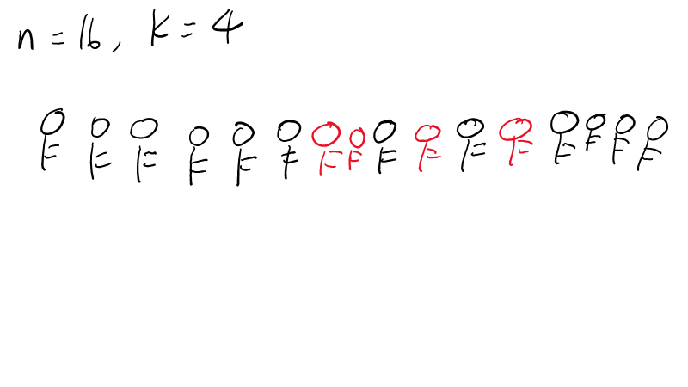

Slide 78
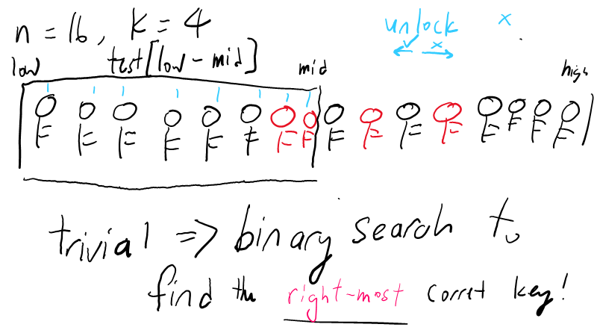

Slide 79
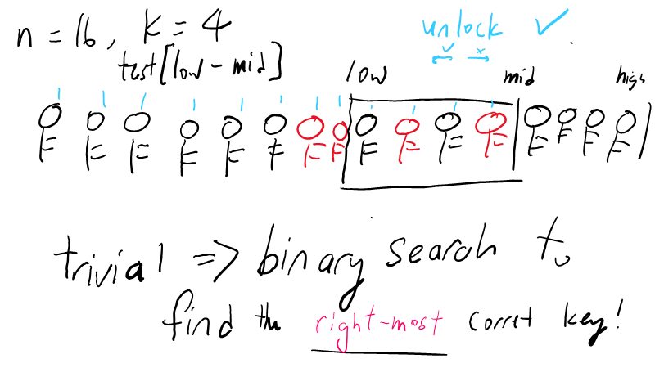

Slide 80
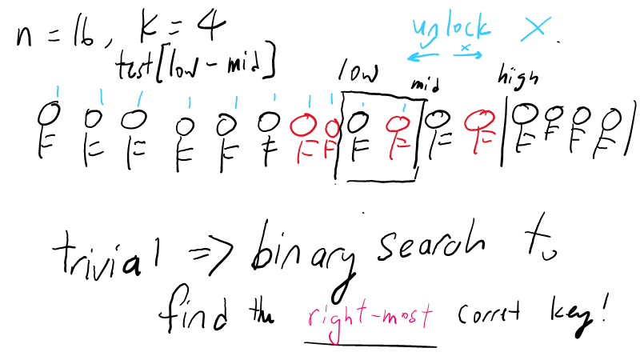

Slide 81
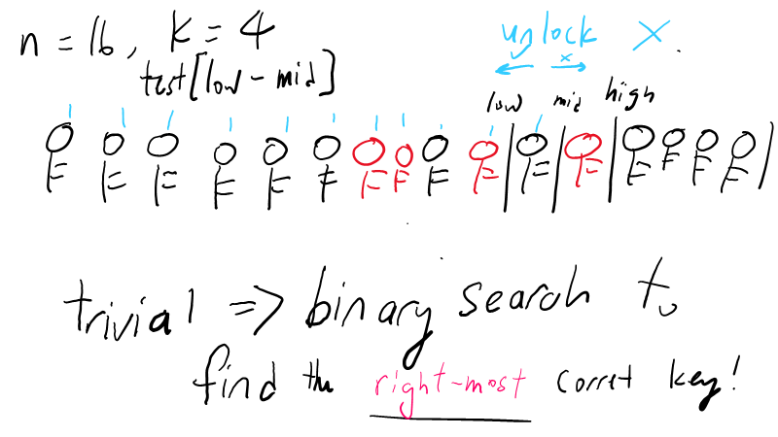

Slide 82
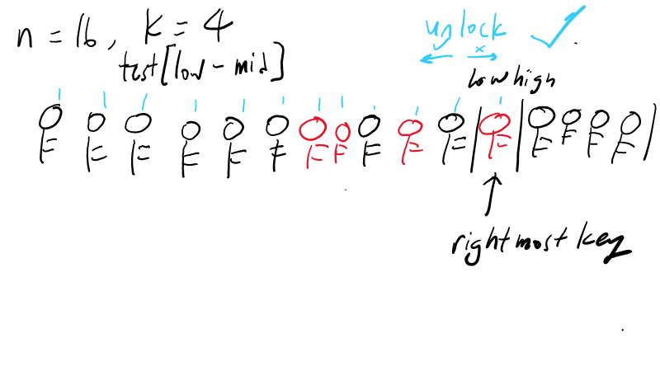

Slide 83
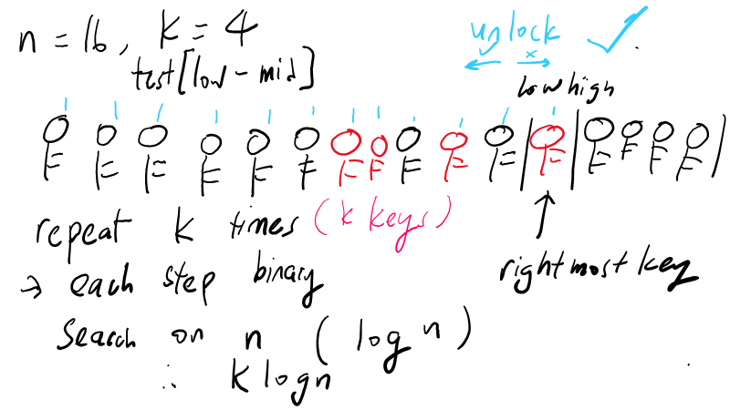

Slide 84
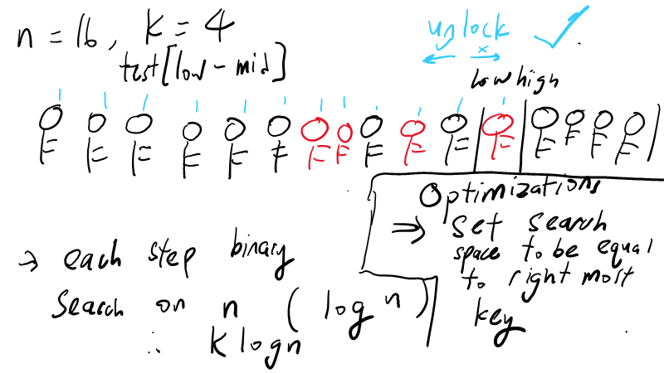

Slide 85
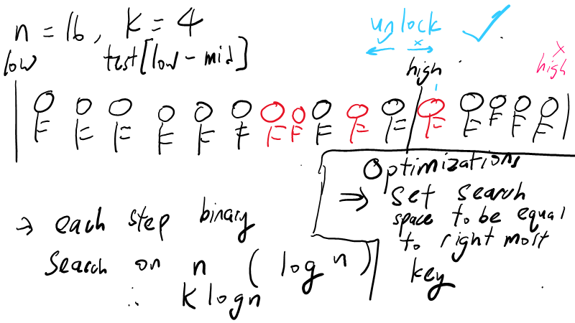

Slide 86
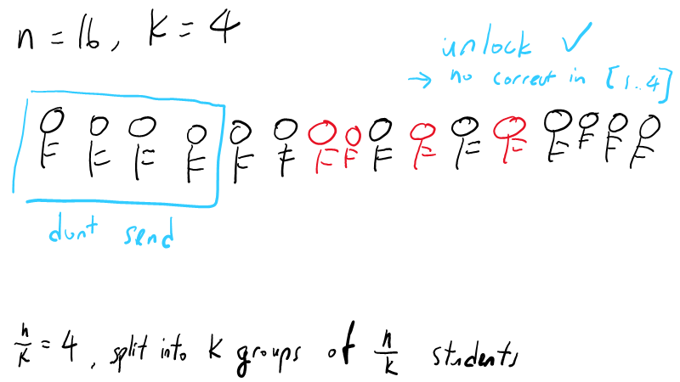

Slide 87
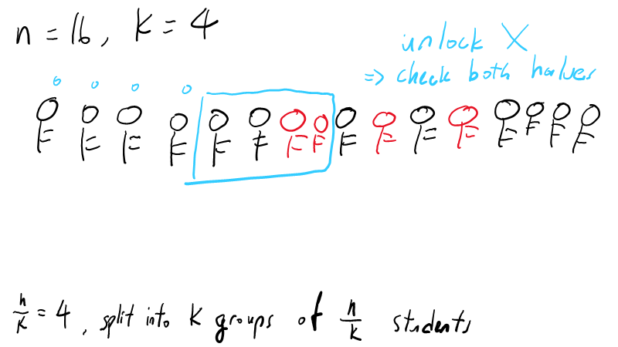

Slide 88
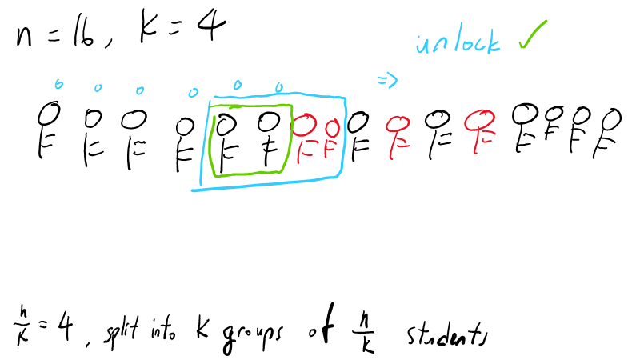

Slide 89
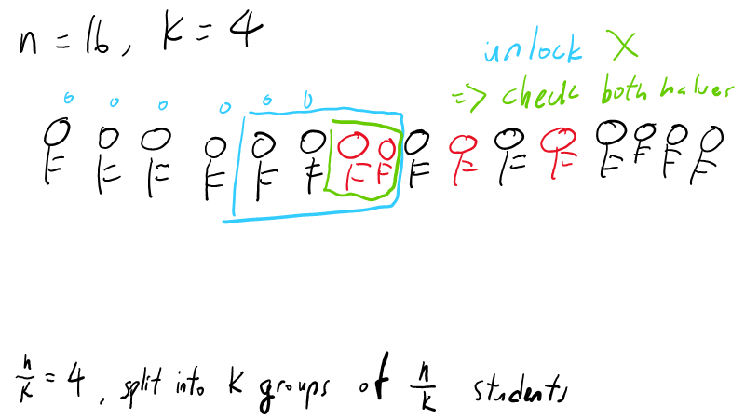

Slide 90
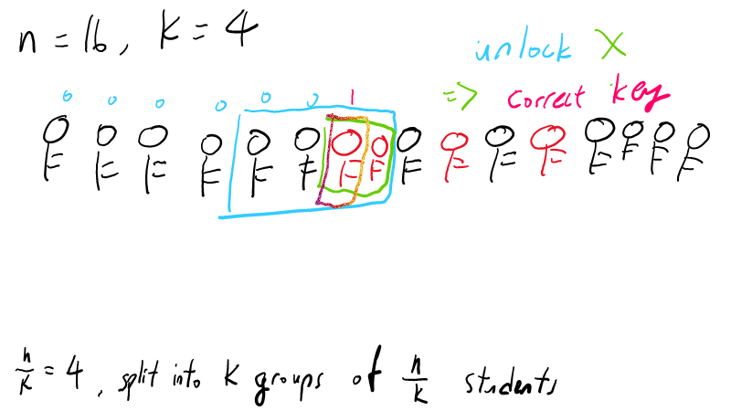

Slide 92
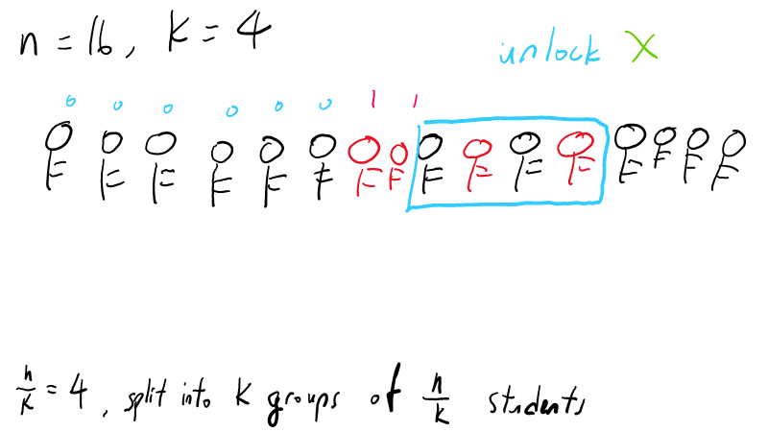

Slide 93
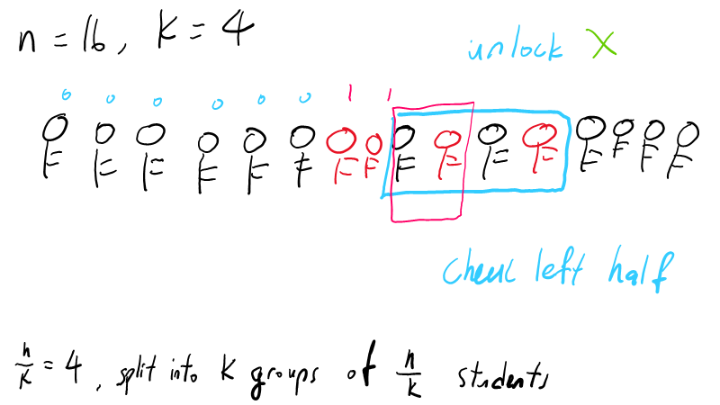

Slide 94
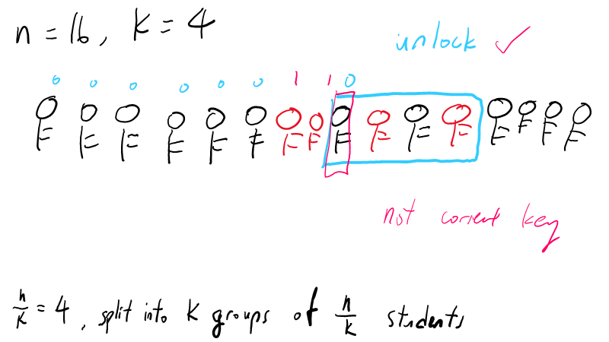

Slide 95
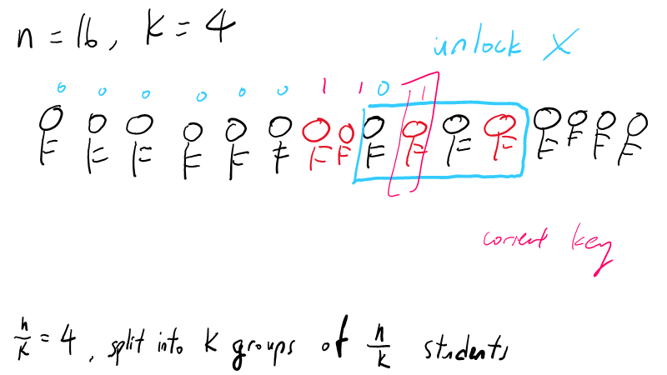

Slide 96
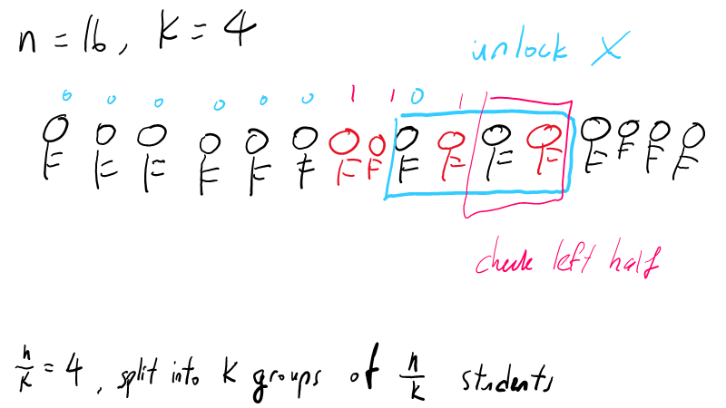

Slide 97
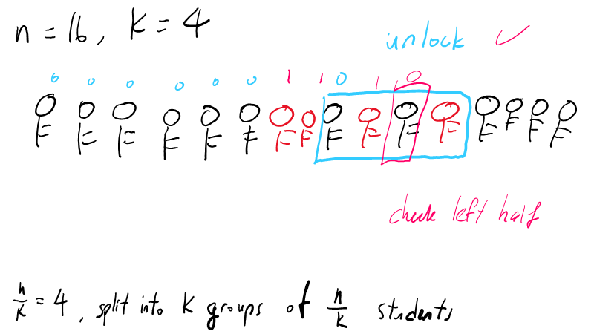

Slide 98
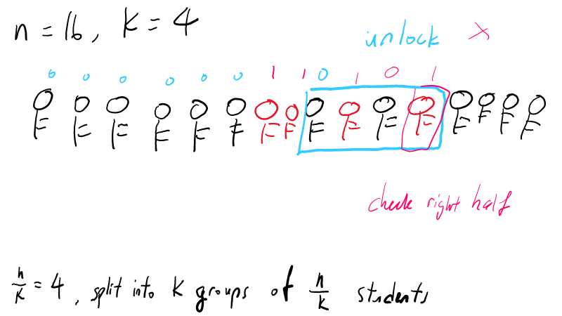

Slide 99
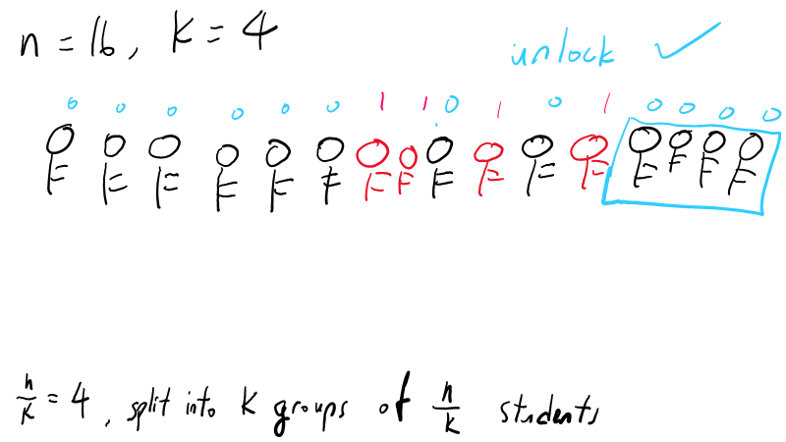

Slide 100
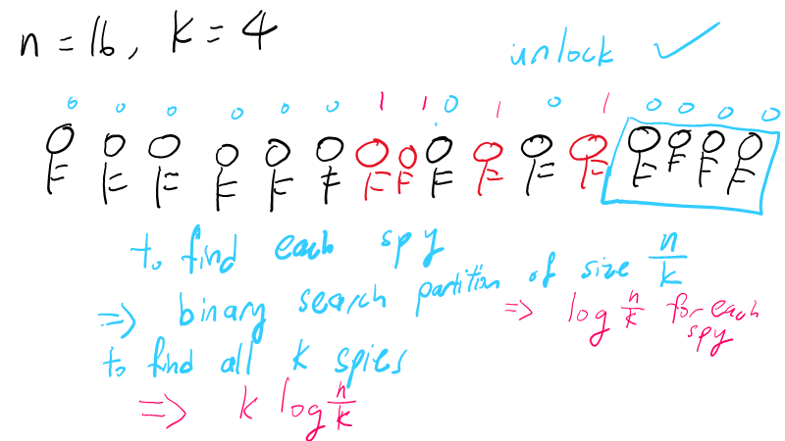

Slide 101
Lastly... Check in
Any questions about the material/content so far?

